Slide 1
Why Now?
Large amounts of Data
Faster computation
Improvement in Neural Net Algorithms
Notes:
Why has it grown?
The huge leap that you see here is due to a couple of factors:
Lots of Data Available: last 10 yrs of so due to DIGITISATION of society, IoT, mobile apps used we can collect more data to use for our traditional learning algorithms.
Faster computation also helps you run your algorithm many times and improve it.
Improvement in Algorithms: more hidden layers, more data to feed into training sets and switching our activation functions from Sigmoid to ReLU( more accuracy).

Slide 2
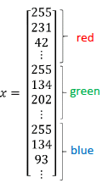
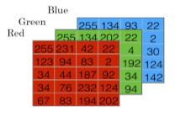

Binary ClassifiCATION
Goal: Predict If Output Is 1(cat) Or 0(non– Cat).
Notation: X, Y, $\hat{Y}$, m, $n_{x}$
64
64
Notes:
How do we feed our images from the tarining set into data that we can work with?
For 1 training example is shown . We do for m training examples and input in feature vector X. Then we have output Y. Now that we have classified our images, we can more onto the next section.
Cat Image:
https://www.google.co.uk/url?sa=i&rct=j&q=&esrc=s&source=images&cd=&cad=rja&uact=8&ved=0ahUKEwjEurCuvsDXAhWLbFAKHc38CTkQjRwIBw&url=http%3A%2F%2Fjonvilma.com%2Fcat.html&psig=AOvVaw2WRjeNFDxfB9-N9fIUuYOt&ust=1510832116324920
Matrix Image:
Coursera Deep Learning & Neural Networks Course by Andrew Ng
Vector Image:
Coursera Deep Learning & Neural Networks Course by Andrew Ng

Slide 3
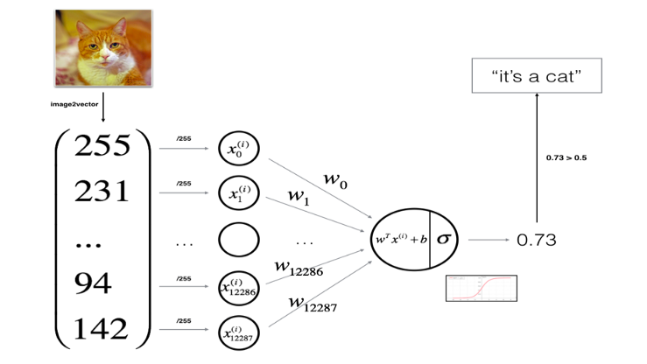

Outline of Logistic Regression Algorithm
Forward Propagation computes Output and error/loss.
Back Propagation computes gradients to update w, b s.t. :
$w≔w − α\frac{dJ}{dw}$
$b≔b − α\frac{dJ}{db}$
Notes:
MACRO: The computations of a neural network are organised as a forward pass/ propagation step which computes the output of our image. Then the backward propagation step updates the weights and the bias to give us the MOST ACCURATE PREDICTION.
Zoom in: The forward prop step converts the image into a vector of pixels ; * by weights(ARBITRARY) and + the bias – this is the regression function. But its between –in and + inf.
To get it to a range (0,1) we divide by maximum pixel intensity and pass through sigmoid function. It then spits out the value between 0 and 1.
Predictions s.t if > 0.5 – Cat
If <= o.5 – not a cat.
FP does something even better; it computes the ERROR between our prediction and actual value of image (1- cat or 0-not cat).
BP updates /trains the initial values of
Sigmoid Image:
https://www.google.co.uk/url?sa=i&rct=j&q=&esrc=s&source=images&cd=&cad=rja&uact=8&ved=0ahUKEwjltqTAvcDXAhVFI1AKHa6vCjMQjRwIBw&url=https%3A%2F%2Ftowardsdatascience.com%2Fmulti-layer-neural-networks-with-sigmoid-function-deep-learning-for-rookies-2-bf464f09eb7f&psig=AOvVaw1ow2yV29iouRsP_j2EWaU0&ust=1510831743465795
Finally when it has done this for m training examples , the w,b value will be at its minimum and this is used as weights for all the images in the test sets .
Image source:
Coursera Deep Learning & Neural Networks Course by Andrew Ng

Slide 4

Gradient descent algorithm
To train parameters “w” and “b”, we need to define the cost function:
Loss/ Error Function: computes the error for a single training example. L(${\hat{y}}^{(i)}$, $y^{(i)})=−(y^{\left(i\right)}\log\left({\hat{y}}^{\left(i\right)}\right)+\left(1−y^{\left(i\right)}\right)log⁡(1−{\hat{y}}^{\left(i\right)})$)
Cost function : Average of loss function for entire training set (m). $J\left(w,b\right)=\frac{1}{m}\sum_{i=1}^{m}{L\left({\hat{y}}^{\left(i\right)}, y^{\left(i\right)}\right)}$
Goal: find optimal w,b to minimise J.
Cost Function Is Convex: So We Can Initialise Anywhere.
J(w,b)
W
b
Notes:
BP updates /trains the initial values of w,b using fancy algorithm called the gradient descent algorithm. To do this , we need the cost function
which is the AVERAGE OF ALL OF THE ERRORs (between our ($\hat{Y}$predictions and the (Y)actual image values).
Note: - GOAL: find lowest w, b that minimises J
- the cost function J is defined in such a way that its CONVEX: i.e. the global optimum = local optimum. This means that wherever we initialise w, and b , after running this process a number of times, we will eventually get the LOWEST W,B that minimises the cost function.
We use these updated values on our test set images to get predictions.
We have IMPLEMENTED this on python and PREDOWNLOADED 3 images: Lets see how well our algorithm performs
NOT SO AWESOME.
Hope you ENJOYED this:
Now Naren will be speaking to you about some other INTERESTING ARCHITECTURES of ANNs.
The goal is to find optimal w,b to minimise J.
For gradient descent, we first initialise the parameter values of w, b to some initial value (denoted by the red dot for example).
Note: We usually initialise at zero.
Since the cost function is convex by definition, no matter where we initialise, we will end up at roughly the same optimal value.
What one step of gradient descent does is it starts at that initial point and takes a step in the steepest downhill direction. This means that we can even end up at the “global optimum” point (the point which gives optimal w,b) even after just one step.

Slide 5

Logistic Regression: Cost Function
To train parameters “w” and “b”, we need to define the cost function:
Loss/ Error Function: computes the error for a single training example. L(${\hat{y}}^{(i)}$, $y^{(i)})=−(y^{\left(i\right)}\log\left({\hat{y}}^{\left(i\right)}\right)+\left(1−y^{\left(i\right)}\right)log⁡(1−{\hat{y}}^{\left(i\right)})$)
Cost function : Average of loss function for entire training set (m). $J\left(w,b\right)=\frac{1}{m}\sum_{i=1}^{m}{L\left({\hat{y}}^{\left(i\right)}, y^{\left(i\right)}\right)}$
Goal: find optimal w,b to minimise J.
Notes:
We do not know what the parameters w and b are thus we need to train them. We DO this using a COST function
TO do this, bear with me here, we need to compute the loss/error for each training example. Error = actual – predicted.

Slide 6

Logistic regression
Definition: Learning Algorithm for Binary Classification
Parameters: w, x, b
Output/ Activation Function : $\hat{y}= σ\left(w^{T}x+b\right)$
Goal: Minimize error between predictions and training data.
i.e. ${\hat{y}}^{(i)} ≈y^{\left(i\right)}$
Notes:
It is a learning algorithm used for Supervised learning where the outputs are all either 0 or 1.
The goal is to minimise the error betweeen its predictions(Y) and the training data($\hat{Y}$).
Explain formula: w= weights b = bias
Sigmoid Image:
https://www.google.co.uk/url?sa=i&rct=j&q=&esrc=s&source=images&cd=&cad=rja&uact=8&ved=0ahUKEwjltqTAvcDXAhVFI1AKHa6vCjMQjRwIBw&url=https%3A%2F%2Ftowardsdatascience.com%2Fmulti-layer-neural-networks-with-sigmoid-function-deep-learning-for-rookies-2-bf464f09eb7f&psig=AOvVaw1ow2yV29iouRsP_j2EWaU0&ust=1510831743465795

